Slide 1
Micro-Credit Defaulter

Slide 2
Agenda
Introduction
Problem statement
Data source
EDA
Visualizations
Testing of Identified Approach
Key Findings
Conclusion and next steps

Slide 3
Introduction
A Microfinance Institution (MFI) is an organization that offers financial services to low income populations.
MFS becomes especially useful when targeting the unbanked poor living in remote areas
Today, microfinance is widely accepted as a poverty-reduction tool, representing $70 billion in outstanding loans and a global outreach of 200 million clients.

Slide 4
Problem Statement
The Consumer is believed to be delinquent if he deviates from the path of paying back the loaned amount within 5 days . So there is a need to Build a model which can be used to predict in terms of a probability for each loan transaction, whether the customer will be paying back the loaned amount within 5 days of insurance of loan..

Slide 5
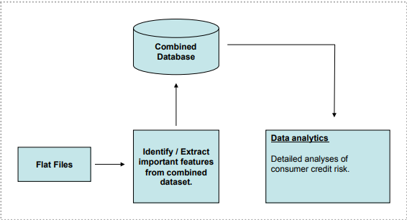
Data Source
The raw data was provided to us in flat-file format.

Slide 6
EDA
Data Processing
As the data was Imbalanced so scaling over data was done.
Imported stats from “scipy” and refined the outliers have z score more than 3.
Dropped un necessary columns as “pcircle,msisdn,pdate”.
Imported normalizer and normalise the data.

Slide 7
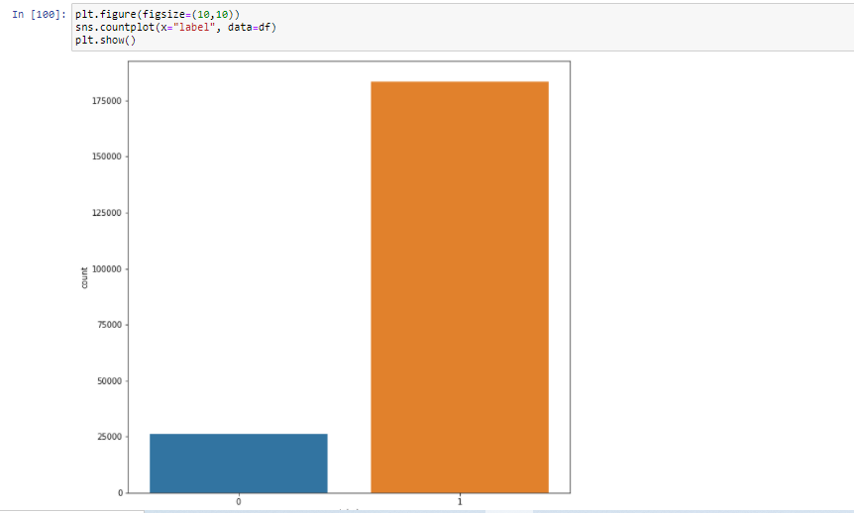
Visualizations
Label count

Slide 8
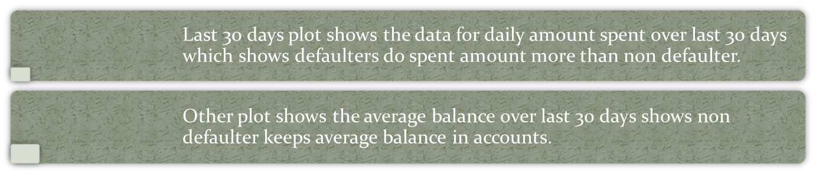
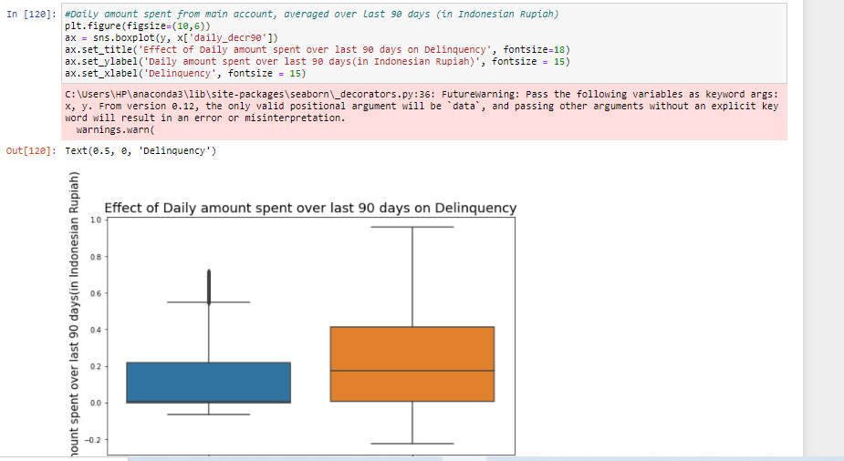
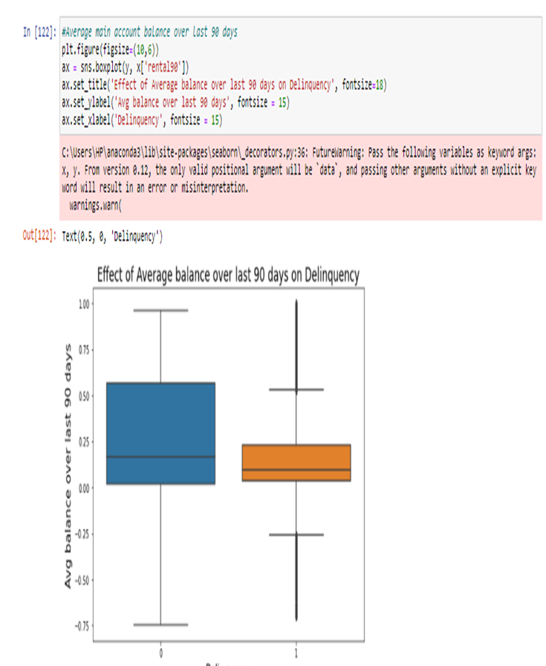
Visualization for 90 days

Slide 9
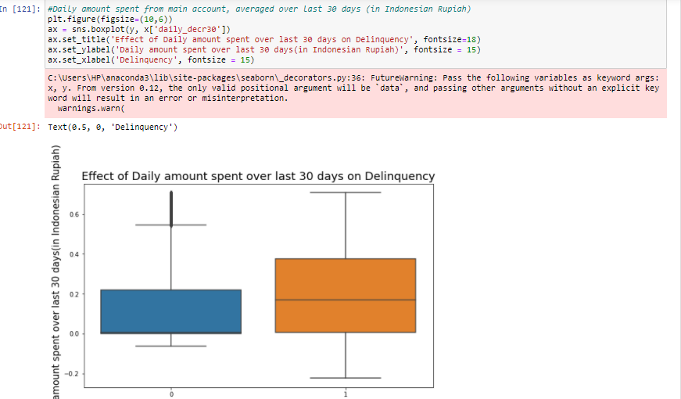
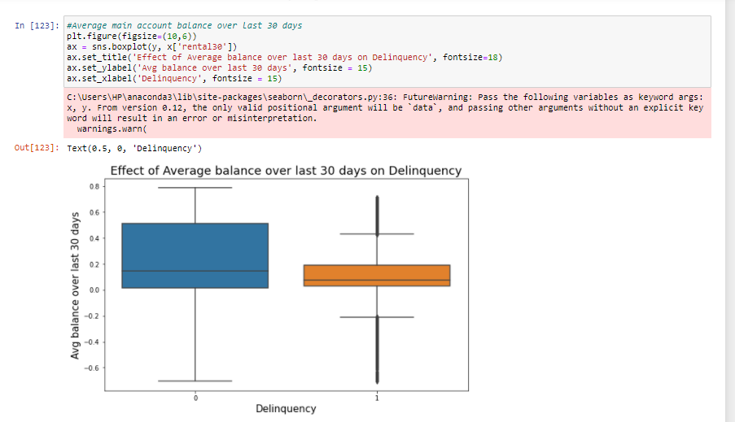
Visualization for 30 days
Last 30 days plot shows the data for daily amount spent over last 30 days which shows defaulters do spent amount more than non defaulter.
Other plot shows the average balance over last 30 days shows non defaulter keeps average balance in accounts.

Slide 10
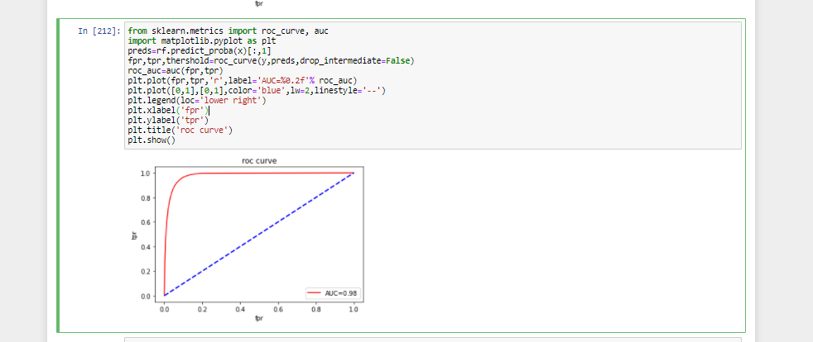
Testing and Identified approach
Out of all of the roc curves above, we can conclude that random forest have better area under curve value.

Slide 11
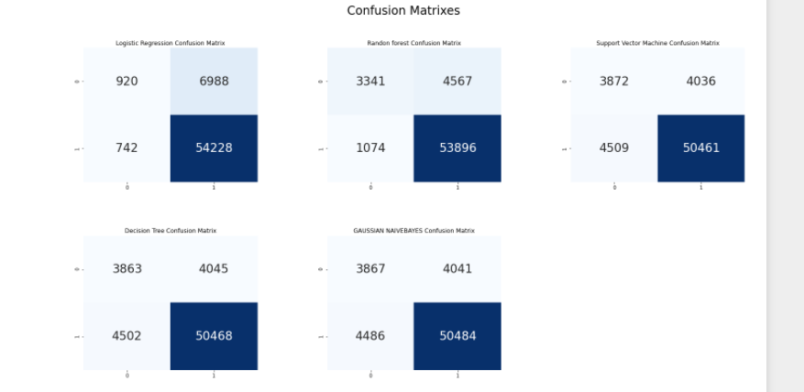
Key findings
“Out of all of the roc curves above, we can conclude that random forest have better accuracy and less errors in comparison”

Slide 12
Conclusion and next steps
“The final model has an Accuracy of 0.91 and AUC_ROC score of 0.70. we also have.... True Negative = 3341 False Positive = 1074 False Negative = 4567 True Positive = 53896 Also, we had low Type-1 Error as FP is less.”
confusion matrix still shows minimum error which can be solved with better solution but still the project can be handled for maximum revenue defaulter less data with the help of the model created above.
Next step

Slide 13
Q AND A

